Slide 1

Semantic Search for Spotify with Sentiment
Problem Statement
Our Solution
Demo
Reflection
Nihong Yi, Sean Holland, Eric Tran, Felix Huang, Trung Le
LLM Fever
Trung and the Heartbreakers

Slide 2
Table of contents
01
Problem Statement
02
Our Solution
03
Demo
04
Reflection
05
Conclusion
Problem Statement
Our Solution
Demo
Reflection
Existing Spotify Search
Semantic Search with Generated Keywords from Llama 2
Live Demonstration of App
Business Impact & Possible Improvements
Highlights & Challenges
LLM Fever
Trung and the Heartbreakers
Notes:
Change this later

Slide 3
01
Problem Statement
Problem Statement
Our Solution
Demo
Reflection
LLM Fever
Trung and the Heartbreakers

Slide 4
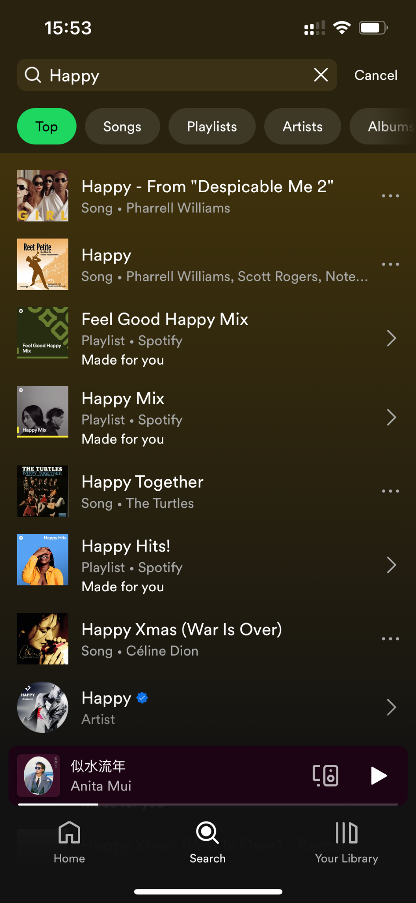
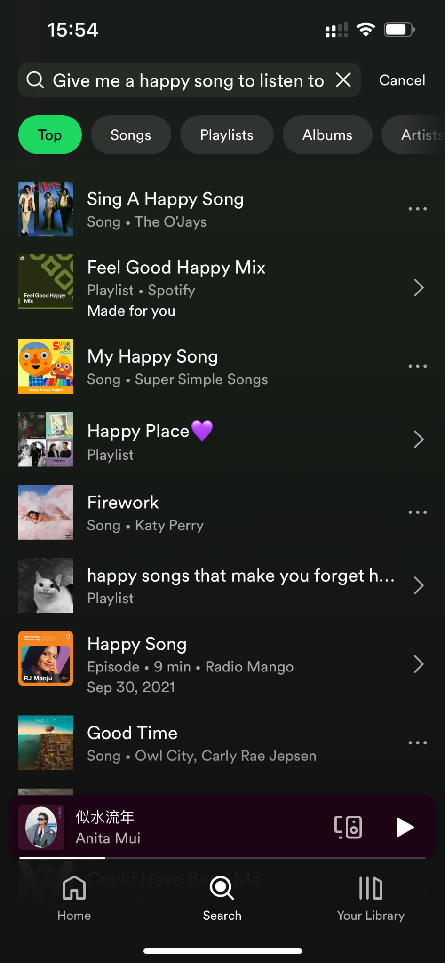
Existing Search Is Not Flexible Enough
Problem Statement
Our Solution
Demo
Reflection
Searching by keywords match
Song title, artist, album name, playlist name, lyrics for matches
Need to know the name of the song or artist
Explore page for playlists (Demo)
LLM Fever
Trung and the Heartbreakers

Slide 5
02
Our Solution
Problem Statement
Our Solution
Demo
Reflection
LLM Fever
Trung and the Heartbreakers

Slide 6
Semantic Search Engine
Problem Statement
Our Solution
Demo
Reflection
Based on user’s natural language input, return songs that satisfy the description or mood in lyrics
57,650 Songs
Up until 2022
Spotify Million Song dataset
643 Artists
4 Columns
Artist, song, link, lyrics
LLM Fever
Trung and the Heartbreakers

Slide 7
Technical Architecture
Problem Statement
Our Solution
Demo
Reflection
Offline
Online
Query
Data Preprocessing
Keywords for Llama API
User Input
Query + Keywords
Embedding
Index w/ FAISS
Spotify API
Play List
Artists + Songs
Backend
Frontend
LLM Fever
Trung and the Heartbreakers

Slide 8
Key Techniques
Data Preprocessing
Embedding
Keywords generation
Problem Statement
Our Solution
Demo
Reflection
Combine artist, song title, lyrics
Remove special characters
No chunking
All-MPNET: accuracy vs speed tradeoff
Indexed with FAISS and HNSW algorithm
Indirectly use external database from pretrained model
Improve search accuracy
LLM Fever
Trung and the Heartbreakers

Slide 9
03
App Demo
Problem Statement
Our Solution
Demo
Reflection
LLM Fever
Trung and the Heartbreakers

Slide 10
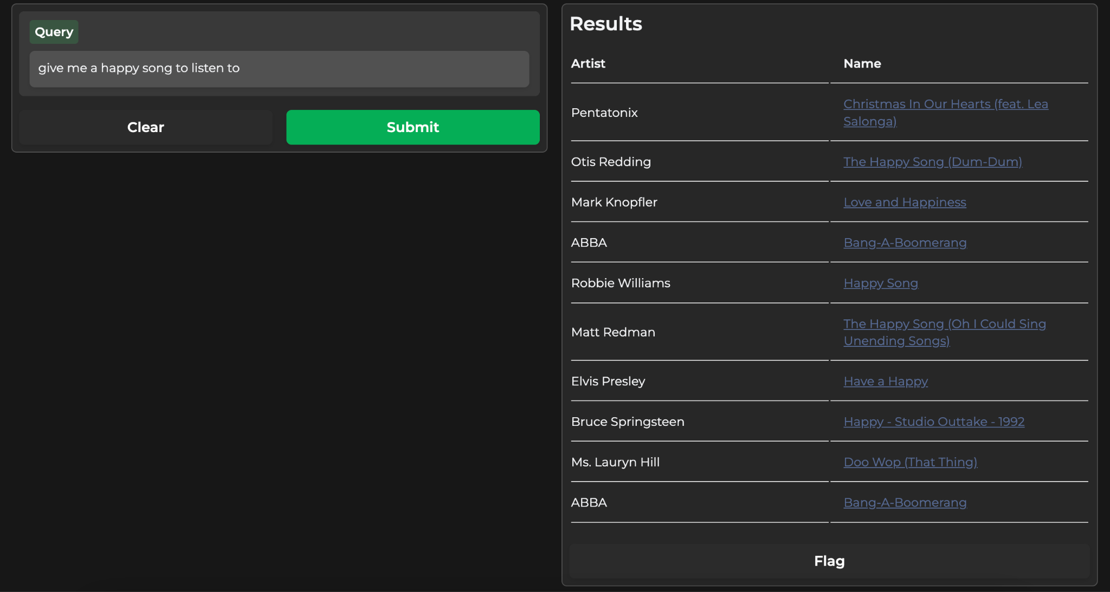
App Demo
Problem Statement
Our Solution
Demo
Reflection
Live Gradio App
LLM Fever
Trung and the Heartbreakers
Notes:
Metrics: songs by abba, lyrics that’s not on the title, a more general descriptive

Slide 11

Problem Statement
Our Solution
Demo
Reflection
Evaluation: Offline Metrics
Query 1
Artist
Query 2
Lyrics
?
Songs by ABBA
113 songs
songs with lyrics "Is this the real life? Is this just fantasy? Caught in a landslide No escape from reality Open your eyes Look up to the skies and see I'm just a poor boy, I need no sympathy"
LLM Fever
Trung and the Heartbreakers
Notes:
Metrics: songs by abba, lyrics that’s not on the title, a more general descriptive

Slide 12

Problem Statement
Our Solution
Demo
Reflection
Evaluation: Offline Metrics
Query 1
Query 2
Songs by ABBA
113 songs
songs with lyrics "Is this the real life? Is this just fantasy? Caught in a landslide No escape from reality Open your eyes Look up to the skies and see I'm just a poor boy, I need no sympathy"
LLM Fever
Trung and the Heartbreakers
Notes:
Metrics: songs by abba, lyrics that’s not on the title, a more general descriptive

Slide 13
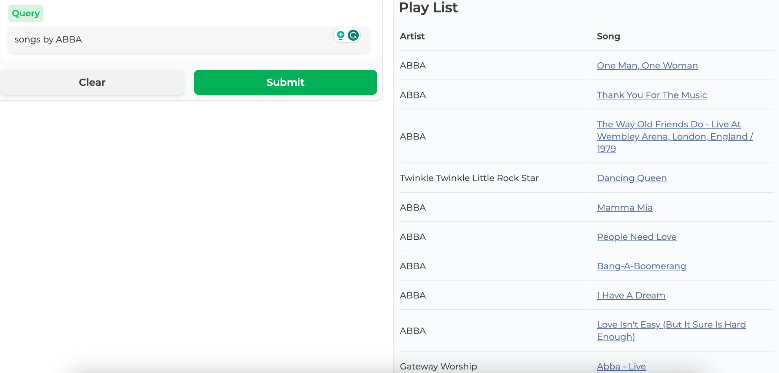
Problem Statement
Our Solution
Demo
Reflection
Evaluation: Offline Metrics
LLM Fever
Trung and the Heartbreakers
Notes:
Metrics: songs by abba, lyrics that’s not on the title, a more general descriptive

Slide 14
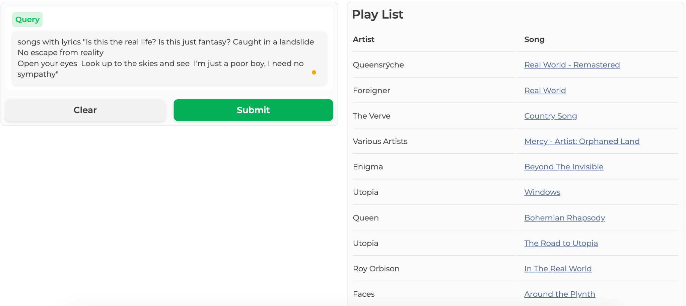
Problem Statement
Our Solution
Demo
Reflection
Evaluation: Offline Metrics
LLM Fever
Trung and the Heartbreakers
Notes:
Metrics: songs by abba, lyrics that’s not on the title, a more general descriptive

Slide 15
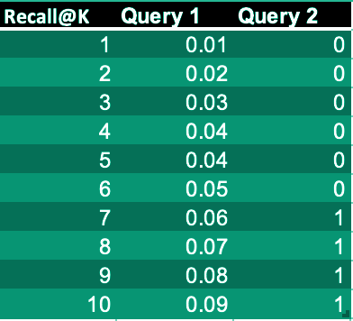
Problem Statement
Our Solution
Demo
Reflection
Evaluation: Offline Metrics
RR for first query: 1.0
RR for second query: 0.14
MRR: 0.57
AP@10_query1 = 0.09
AP@10_query2 = 0.14
MAP@10 = 0.12
LLM Fever
Trung and the Heartbreakers
Notes:
Metrics: songs by abba, lyrics that’s not on the title, a more general descriptive

Slide 16
04
Reflection
Problem Statement
Our Solution
Demo
Reflection
LLM Fever
Trung and the Heartbreakers

Slide 17

Business Impacts
Problem Statement
Our Solution
Demo
Reflection
Improving user engagement through better search results
Enabling more new artists to be discovered
Potential monetization opportunity (paid search result)
LLM Fever
Trung and the Heartbreakers

Slide 18
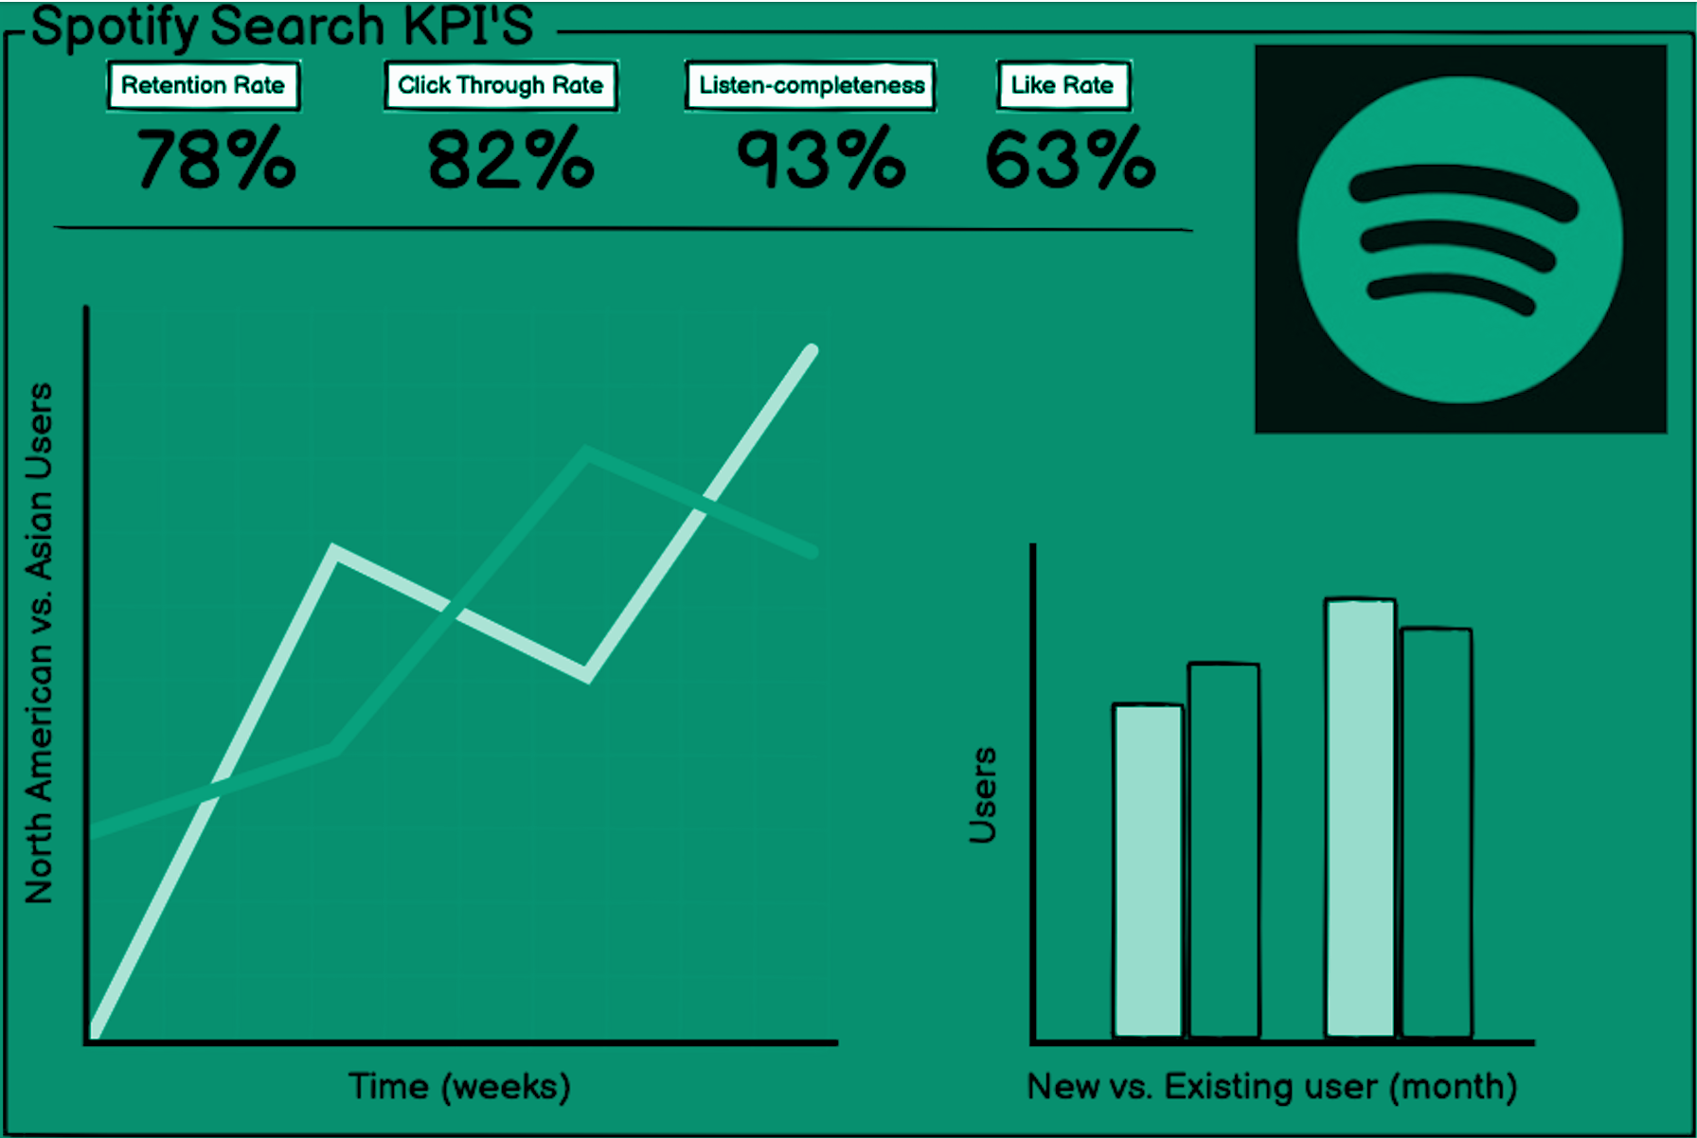
Follow-up Steps
Problem Statement
Our Solution
Demo
Reflection
Building a KPI dashboard with a fully running and online app
Integration with Spotify DJ (more interactive)
Support multi languages
Integrate music metadata to model
Musical Qualities
Music Era
Vocal Style
LLM Fever
Trung and the Heartbreakers

Slide 19
05
Conclusion
Problem Statement
Our Solution
Demo
Reflection
LLM Fever
Trung and the Heartbreakers

Slide 20
Problem Statement
Our Solution
Demo
Reflection
Challenges
Data
Performance
Limited features: lack of attributes such as musicality, valence, etc
Data Cleaning: ‘chorus’ ‘2x’
Lack of access to GPT API
Improvement on speed: call 2 different APIs, usage of GPU
LLM Fever
Trung and the Heartbreakers

Slide 21
Problem Statement
Our Solution
Demo
Reflection
Highlights
Business Problem
Eco-system
Tackle a real world problem that has been a pain point
Go the extra mile and design how to create synergy effect
Innovative Use of Generative AI
Enrich our query content by incorporating Llama AI
LLM Fever
Trung and the Heartbreakers

Slide 22

Thank You!
Love is my weapon, music is my religion, peace is in my soul.
Problem Statement
Our Solution
Demo
Reflection
LLM Fever
Trung and the Heartbreakers
Notes:
Hnsw: better integrate into spotify eco system https://engineering.atspotify.com/2023/10/introducing-voyager-spotifys-new-nearest-neighbor-search-library/

